Slide 1





AMERICAN INTERNATIONAL UNIVERSITY BANGLADESH
Cyber-Bullying on the AIUB Campus and the role of Mobile Applications to Reduce it
PRESENTED BY: GROUP - H
SUPERVISED BY
Fariha Tasnim Sunanda | 23-54942-3
Sarita Islam Usmita | 24-56695-1
Md. Shafiqur Rahman | 24-57262-2
Nazib Hasan Tasin | 24-56652-1
Shimanta Shaha | 24-57227-2
Hriduan Omor Siam | 23-55770-3
Name: | Dr. Mahfuza Khatun
Designation: | Associate Professor, Faculty
Department: | Department Of Mathematics

Slide 2


Presentation Overview
Abstract
Introduction
Data Source
Methodology
Analysis (Results)
Discussion
Conclusion

Slide 3


Abstract
Context & Focus
Findings & Outcome
Cyberbullying is a growing concern in university environments. This research examined the AIUB campus specifically, utilizing a quantitative survey of 23 students to identify the scale of the problem and potential solutions.
Online harassment was identified as the most prevalent form. However, there is strong student support for AI-based mobile reporting. The proposed outcome is an app-based monitoring system paired with awareness programs.

Slide 4


Introduction
Background: Widespread social media use for academic interaction increases exposure to harmful behavior.
The Problem: Cyberbullying negatively impacts mental well-being, confidence, and academic communication.
The Gap: A lack of effective, confidential reporting systems discourages victims from coming forward.
Hypothesis: Students will favor technology-based reporting tools (Mobile Apps) as a primary solution.

Slide 5








Data Source
Primary Data
Secondary Data
Participant Profile
Collected via a structured online questionnaire (Google Forms) distributed directly to AIUB students.
Peer-reviewed academic journal articles regarding digital communication and reporting systems.
Data retrieved from 23 students who engaged in the survey voluntarily.

Slide 6








Methodology
Research Design
Sampling
Instrument
Ethics
Quantitative descriptive research design.
Convenience sampling within the AIUB community.
13-question survey (Multiple choice & Likert Scale).
Guaranteed anonymity and confidentiality.

Slide 7
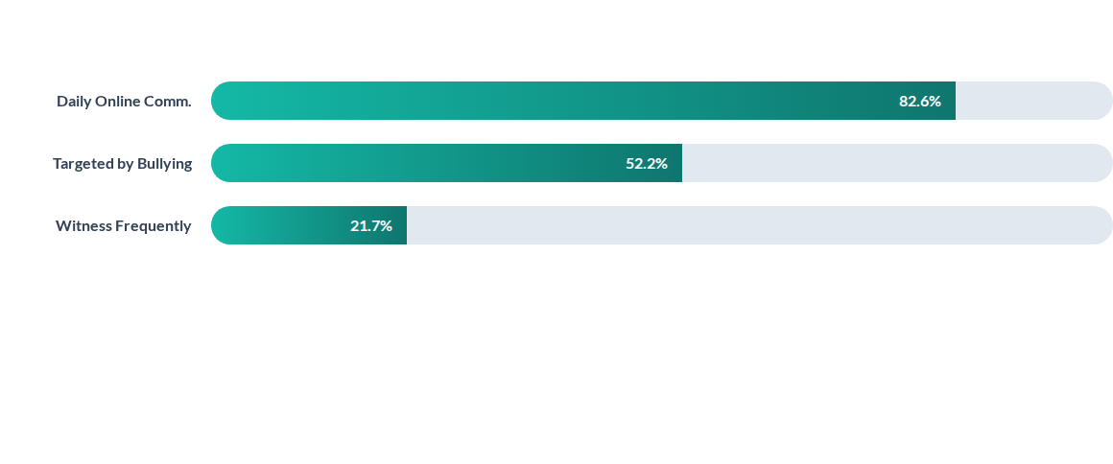
Analysis & Results
Key Insight: Most respondents consider the issue "Serious". Common forms include online harassment, fake accounts, and insulting messages.

Slide 8
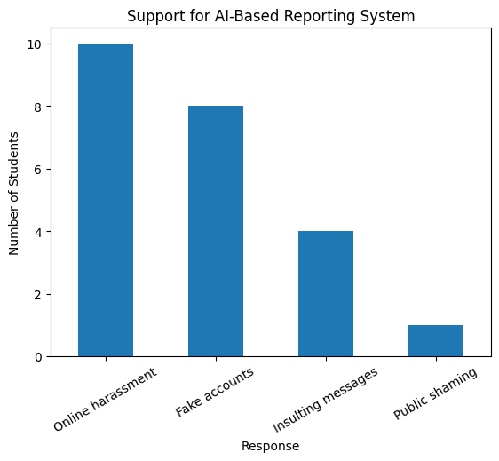
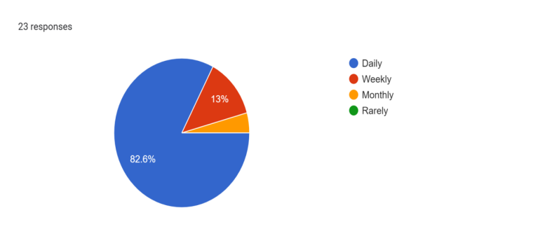
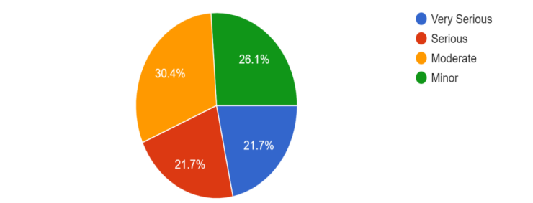
Figure 2 displayed students’ perceptions of cyberbullying. Most respondents considered cyberbullying a serious issue, showing awareness of its negative impact on students’ well-being and academic communication.Overall, the results demonstrated that cyberbullying was a common concern among AIUB students and highlighted the need for effective preventive and reporting systems to reduce cyberbullying on campus.
Fig-1: AI based reporting system
Figure 1: illustrated students’ opinions on the need for an AI-based reporting system. The results showed that online harassment was the main concern, followed by fake accounts and insulting messages, while public shaming occurred less often. These findings indicated strong student support for technology-based reporting systems.
Fig-3: Student communicate with AIUB
Figure 3 showed that 82.6% students used online communication daily, highlighting the strong role of digital platforms in students’ academic and social interactions. This frequent use increased exposure negative online.
Fig-2: How concern about cyber-bullying

Slide 9
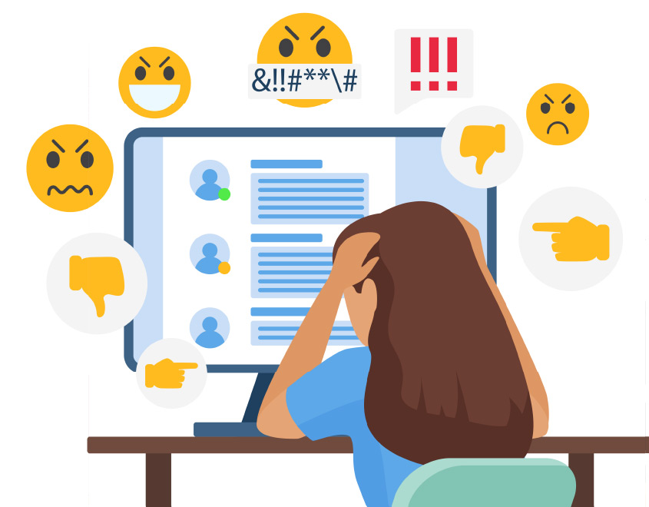
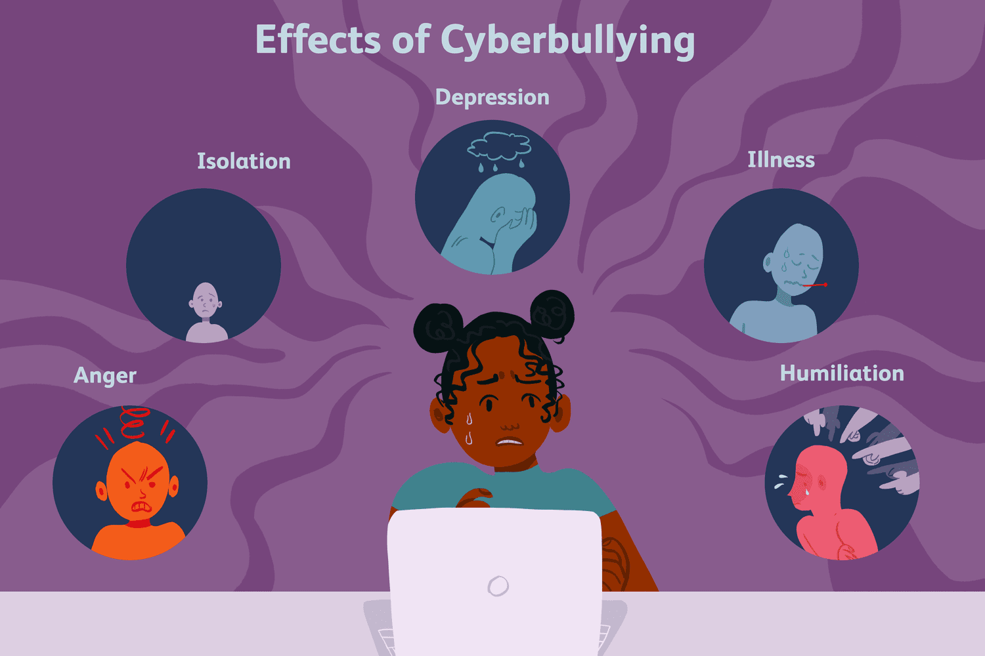
Discussion:
Online Communicaton
52.2% responders experienced online harasment
Mental health
Effect on aceademic performance

Slide 10
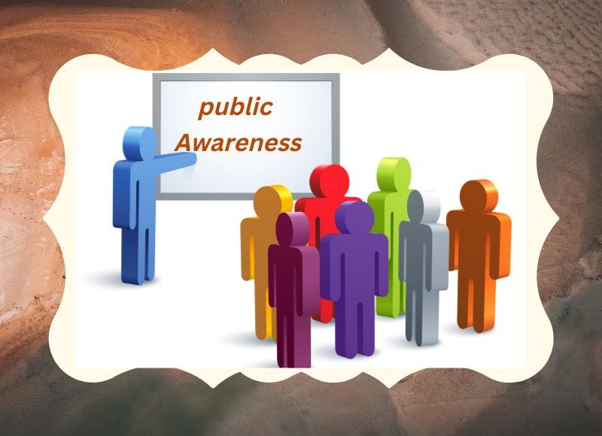
App based reporting system
Clear university policy with zero talarancy

Slide 11



Conclusion & Path Forward
Cyberbullying persists as a critical challenge in our digital campus life. Our findings confirm that students are ready for a technological intervention.
Primary Solution: Mobile App
An AI-powered, anonymous reporting application is the most effective tool to empower students and ensure safety without fear of retaliation.
Holistic Support System
Technology must be supported by institutional policies, mental health counseling, and active awareness workshops.

Slide 12
Limitations:
This study had several limitations. The sample size was small, with data collected from only 23 students, which limited the generalizability of the findings. The study relied on self-reported responses, which may have been influenced by personal perceptions or response bias. Additionally, the research focused on a single university, so the results may not represent students from other institutions.
Suggestions:
Future studies could include a larger and more diverse sample to improve the reliability of the findings. Further research may also evaluate the effectiveness of specific mobile or AI-based reporting systems in real campus settings. In addition, AIUB could consider implementing a pilot app-based reporting system along with regular awareness programs to promote responsible online communication and reduce cyberbullying incidents.

Slide 13


Thank You!
Together we can create a safer digital campus.
Any Questions?

